Slide 1





UrbanFlow
AI-Driven Smart Traffic Control
-Team ACE

Slide 2


the urban mobility crisis
PROBLEM
IMPACT
🚦 Fixed signal timings
🚑 DELAYED EMERGENCY RESPONSE
🏙 OUTDATED INFRASTRUCTURE
📊 LACK OF TRAFFIC VISIBILITY/DATA
WASTES 4.8 billion hours globally per yeaR
COST OF A LIFE
TOO EXPENSIVE TO REPLACE AT CITY SCALE
INCREASED CONGESTION, EXTENDED DELAYS

Slide 3


INTRODUCING URBANFLOW
AI-ENABLED ADAPTIVE TRAFFIC LIGHT CONTROL PLATFORM
USES MOTION AND DENSITY SENSORS TO REGULATE SIGNALS DYNAMICALLY
REAL-TIME EMERGENCY VEHICLE PRIORITIZATION
MODULAR, SCALABLE, AND COST-EFFICIENT FOR URBAN DEPLOYMENT

Slide 4

OUR MISSION AND GOALS
⏱ REDUCE TRAFFIC CONGESTION – CUT IDLE TIME BY 40%
🚨 ACCELERATE EMERGENCY MOVEMENT – INSTANTLY DETECT AND CLEAR PATHS
📊 EMPOWER CITY PLANNING – DELIVER REAL-TIME AND HISTORICAL INSIGHTS

Slide 5
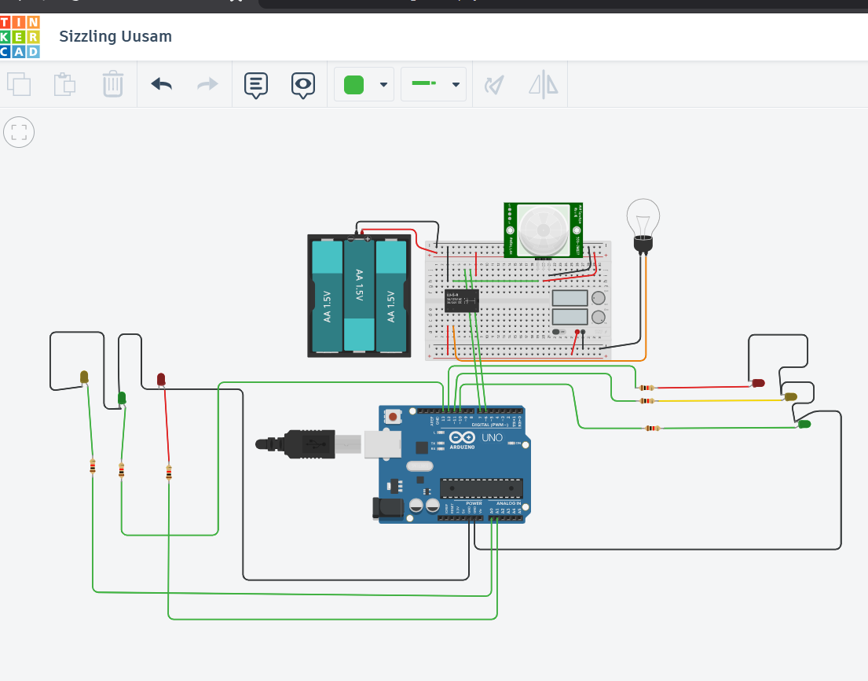
THE URBANFLOW ARCHITECTURE

Slide 6
WORKING PROTOTYPE OVERVIEW

Slide 7

UNIQUE INNOVATIONS
AI-POWERED ADAPTIVE TRAFFIC LIGHTS
LIVE TRAFFIC UPDATES + SMART DASHBOARD
EMERGENCY VEHICLE PRIORITY MODE
UNMANAGED TRAFFIC INTEGRATION
ACCIDENT PREVENTION

Slide 8
Quantifiable results
WHAT WE AIM TO DO
OUR GOAL(BY END OF PILOT)
🚦 CUT TRAFFIC WAITING TIME
🚑 HELP EMERGENCY VEHICLES
🏙️ TEST IN REAL CITIES
📊 SHOW LIFE TRAFFIC DATA
REDUCE AVERAGE RED LIGHT WAIT BY 30%
MAKE EMERGENCY ROUTES 3X FASTER
DASHBOARD UPTIME 95%+ WITH REAL-TIME INFO
RUN PILOT AT 3 INTERSECTIONS IN 3 MONTHS

Slide 9
cHALLENGES AND SOLUTIONS
PROBLEM
HOW WE FIX IT
🌧 WEATHER CAN BREAK SENSORS
📶 INTERNET MAY GO DOWN
🏗️ OLD TRAFFIC LIGHTS
🔒 PRIVACY CONCERNS
USE WATERPROOF COVERS TO PROTECT THEM
USE LOCAL CONTROL THAT WORKS OFFLINE
ADD EASY-TO-INSTALL UPGRADE MODULES
ENCRYPT DATA AND KEEP USER INFO SAFE

Slide 10
WHY URBANFLOW?
MADE TO WORK IN REAL CITIES, NOT JUST LABS.
EASY AND CHEAP TO INSTALL AND USE.
CAN GROW FROM SMALL TESTS TO WHOLE CITY SYSTEMS.
GIVES CITIES USEFUL INFO FAST TO FIX TRAFFIC PROBLEMS.

Slide 11

JOIN THE FUTURE OF TRAFFIC
“TOGETHER, WE CAN REINVENT HOW CITIES MOVE.”

